Slide 1

CS4225/CS5425 Big Data Systems for Data Science
Tutorial 1: MapReduce
Goh Teck Lun
School of Computing
National University of Singapore
gtecklun@comp.nus.edu.sg

Slide 2
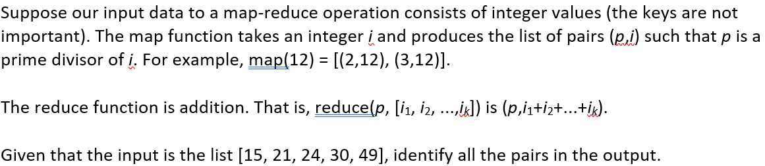
Question 1:

Slide 3
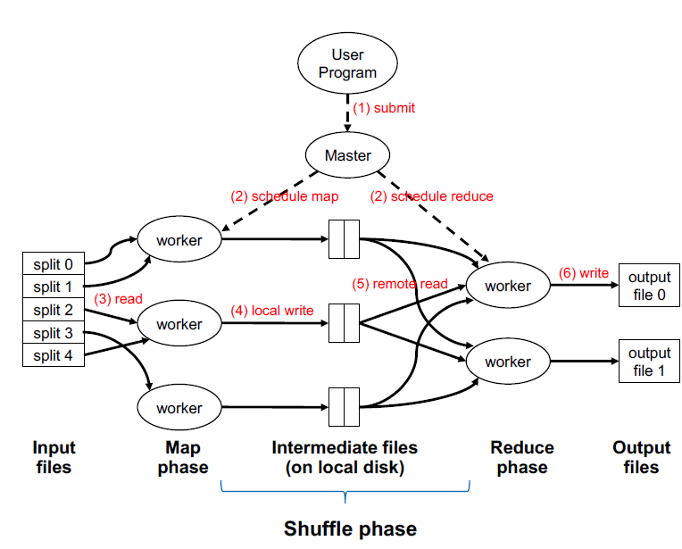
Solution 1:
Input Files:
[15, 21, 24, 30, 49]
Map Phase: “The map function takes an integer i and produces the list of pairs (p,i) such that p is a prime divisor of I”
15 -> (3,15), (5,15)
21 -> (3,21), (7,21)
24 -> (2,24), (3,24)
30 -> (2,30), (3,30), (5,30)
49 -> (7,49)

Slide 4
Solution 1:
Output of Map Phase
15 -> (3,15), (5,15)
21 -> (3,21), (7,21)
24 -> (2,24), (3,24)
30 -> (2,30), (3,30), (5,30)
49 -> (7,49)
Shuffle Phase (automatic) : Reduce workers remote read data grouped by keys
(2, [24, 30])
(3, [15, 21, 24, 30])
(5, [15, 30])
(7, [21, 49])

Slide 5
Solution 1:
Input of Reduce Phase
(2, [24, 30])
(3, [15, 21, 24, 30])
(5, [15, 30])
(7, [21, 49])
Reduce Phase: “The reduce function is addition. That is, reduce (p, [i₁, i₂, …, i_{k}] is (p, i₁ + i₂+ … + i_{k})”
(2,54)
(3,90)
(5,45)
(7,70)

Slide 6
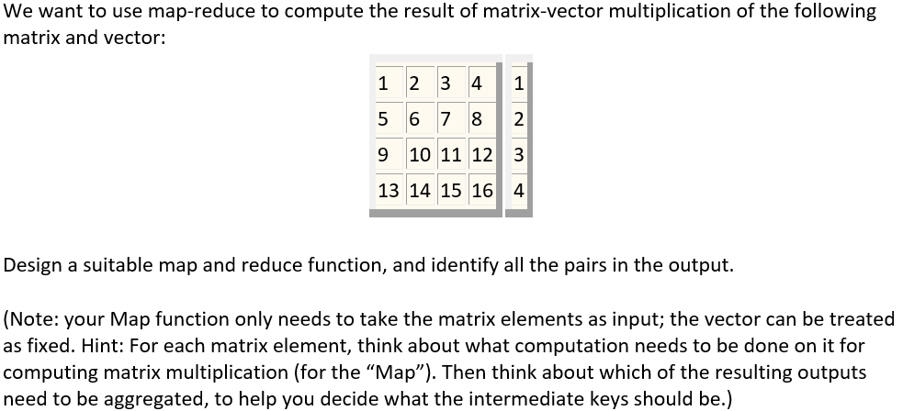
Question 2:

Slide 7
Solution 2:
Large matrix
(n x m)
Small vector
(m x 1)
Too large to be stored on single machine. To be distributed to cluster of machines. Map function takes matrix elements as input
n >> m
Fixed vector stored on every machine in cluster
input to the mapper function is (value, row, col). e.g:
(1, 1, 1), (2, 1, 2), … , (16, 4, 4)

Slide 8
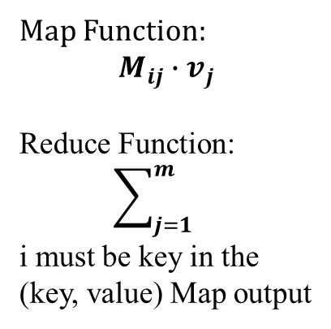
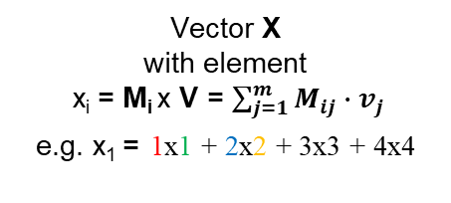
Solution 2:
Map Input :
(1, 1, 1),
(2, 1, 2),
… ,
(16, 4, 4)
(M_{ij}, i, j)
(n x m)
(m x 1)
(n x 1)
Map Function:
$$M_{ij}∙v_{j}$$
Reduce Function:
$$\sum_{j=1}^{m}{}$$
i must be key in the (key, value) Map output
1x1 + 2x2 + 3x3 + 4x4
5x1 + 6x2 + 7x3 + 8x4
9x1 + 10x2 + 11x3 + 12x4
13x1 + 14x2 + 15x3 + 16x4
x
=
Matrix M
with Matrix Element, M_{ij}
Vector V
with element
v_{j}
Vector X
with element
x_{i} = M_{i} x V = $\sum_{j=1}^{m}{M_{ij}∙v_{j}}$
e.g. x₁ = 1x1 + 2x2 + 3x3 + 4x4

Slide 9

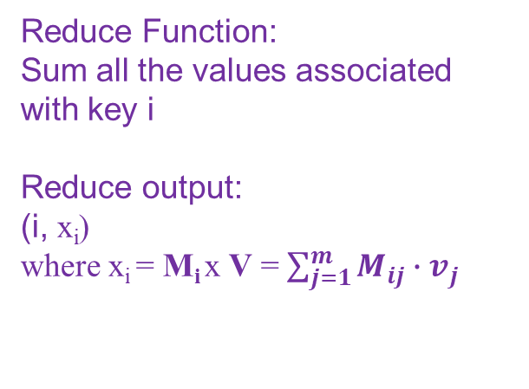
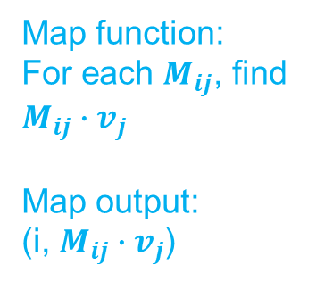
Solution 2:
Map Input :
(1, 1, 1),
(2, 1, 2),
… ,
(16, 4, 4)
($M_{ij}$, i, j)
Map function:
For each $M_{ij}$, find $M_{ij}∙v_{j}$
Map output:
(i, $M_{ij}∙v_{j}$)
Reduce Function:
Sum all the values associated with key i
Reduce output:
(i, x_{i})
where x_{i} = M_{i} x V = $\sum_{j=1}^{m}{M_{ij}∙v_{j}}$
Map Function:
$$M_{ij}∙v_{j}$$
Reduce Function:
$$\sum_{j=1}^{m}{}$$
i must be key in the (key, value) Map output

Slide 10
Solution 2:
1x1 + 2x2 + 3x3 + 4x4
5x1 + 6x2 + 7x3 + 8x4
9x1 + 10x2 + 11x3 + 12x4
13x1 + 14x2 + 15x3 + 16x4
x
=
Map: Thus, in row-major order, the sixteen key-value pairs produced are:
Reduce: sum the values corresponding to the same key, thus, results of reduce are: (1,30), (2,70), (3,110), (4,150)

Slide 11
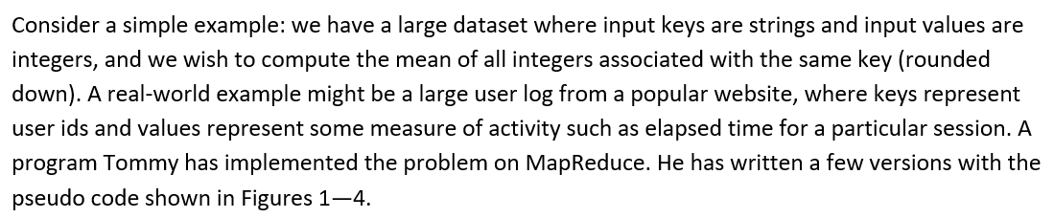
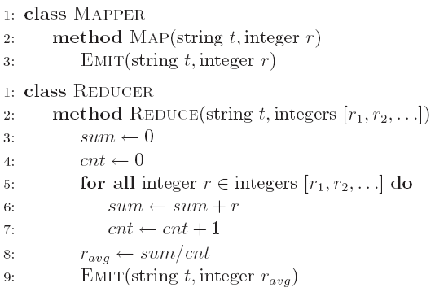
Question 3a:
a) Initially, Tommy has finished an implementation with Version 1 (Figure 1). He finds that the implementation can have correct results, but the performance is very slow. Why?
Notes:
We can assume this is the result of word count on every single document
Which is the occurrence of word on the whole dataset..

Slide 12
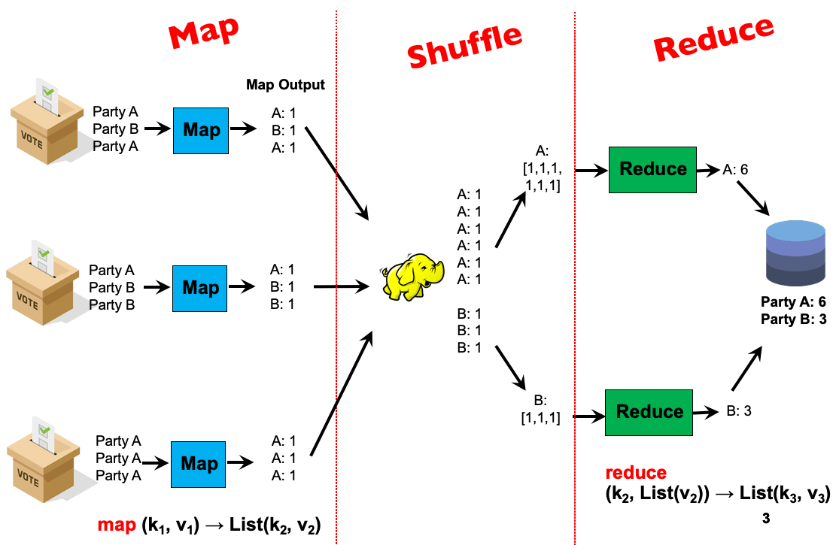

Solution 3a:
It requires shuffling all key-value pairs from mappers to reducers across the network, which is highly inefficient.
key
value

Slide 13
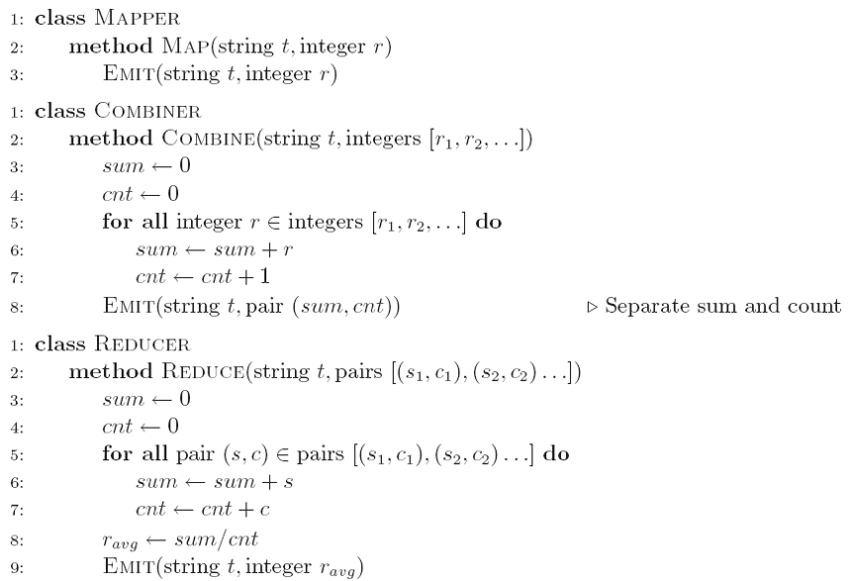
Question 3b:
b) Tommy wants to improve the performance using combiner. He comes out the second implementation (Version 2 in Figure 2). He finds that he can seldom get the reasonable results. Why?
Notes:
We can assume this is the result of word count on every single document
Which is the occurrence of word on the whole dataset..

Slide 14
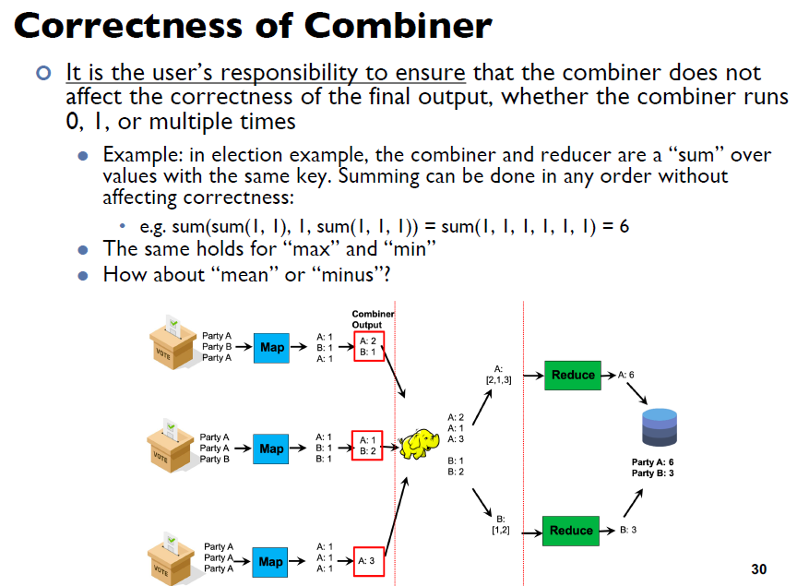
Solution 3b: Recap – Lecture 2 Slide 30
Combiner reduces number of data transmission, BUT
algorithm in Combiner must be designed such that MapReduce still work even if Combiner did not execute.

Slide 15
Solution 3b:
Case 1: Combiner always run
MapReduce works as combiner output has same key-value type as reducer input
Case 2: Combiner not run sometimes
MapReduce does not work as map output has different key-value type as reducer input
Combiners must have the same input and output key-value type, which also must be the same as the mapper output type and the reducer input type.
Notes:
We can assume this is the result of word count on every single document
Which is the occurrence of word on the whole dataset..

Slide 16
Solution 3b:
Recall that combiners must have the same input and output key-value type, which also must be the same as the mapper output type and the reducer input type.
To understand why this restriction is necessary in the programming model, remember that combiners are optimizations that cannot change the correctness of the algorithm. The user needs to ensure that the program output is still correct, regardless of whether the combiner runs 0, 1, or multiple times.
If the combiner does not run (that is, the map output is fed directly to the reduce function), the output value type of the mapper is integer, so the reducer receives a list of integers as values. But the reducer actually expects a list of pairs!

Slide 17
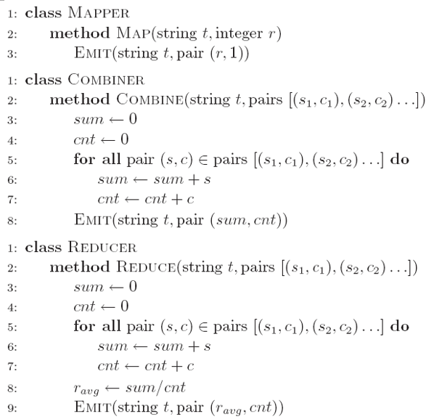
Question 3c:
c) After careful design, Tommy finally develops an efficient and correct implementation (Version 3 in Figure 3). Analyze the correctness of the combiner and efficiency of the algorithm (i.e., why it is more efficient than Version 1).
Notes:
We can assume this is the result of word count on every single document
Which is the occurrence of word on the whole dataset..

Slide 18
Solution 3c:
Mapper:
Key: string t
Value: a pair consisting of integer and 1
This corresponds to a partial count over 1 instance
Combiner:
Combiner aggregates the partial sums and the partial counts and emits pairs with updated sums and counts.
The number of key-value pairs is reduced, thus shuffle and sort can be more efficient.
Reducer:
Similar algorithm as combiner, with mean is computed at the end.
In essence, the algorithm transforms a non-associative operation (mean of numbers) into an associative operation (element-wise sum of a pair of numbers, with an additional division at the very end).
Associative Operation: (a+b)+c=a+(b+c)

Slide 19
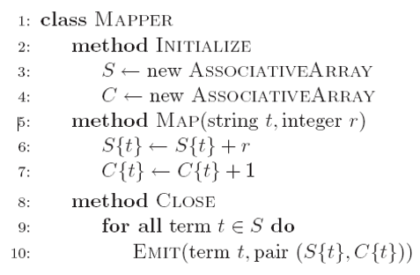
Question 3d:
d) Tommy analyzes the efficiency of Version 3, and comes out an even more efficient implementation (Version 4 in Figure 4). Why is Version 4 even more efficient than Version 3?
Notes:
We can assume this is the result of word count on every single document
Which is the occurrence of word on the whole dataset..

Slide 20
Solution 3d:
Inside the mapper, the partial sums and counts associated with each string are held in memory across input key-value pairs. Intermediate key-value pairs are emitted only after the entire input split has been processed; similar to before, the value is a pair consisting of the sum and count. The Map function reduces the number of key value pairs, so that the IO cost is reduced (and there is no need for the combiner in this case).
Version 3
Version 4

